Slide 1
Reporting Hepatitis B in the North Carolina Electronic Disease Surveillance System (NC EDSS)
Notes:
Good morning and welcome, I’m Brian Gravlin the Viral Hepatitis Surveillance nurse with the Communicable Disease Branch. Today we will be discussing how to report HBV events in NCEDSS. This training is primarily aimed at new CD nurses who have little experience with NC EDSS and nuisances associated with HBV. If you are unable to attend the entire training or you are called to leave not to worry this training is being recorded and will be made available in the CD manual along with this PowerPoint.

Slide 2
Goals
Understand the sequence for evaluating a person who was not previously reported for hepatitis b against the case definitions.
Change hepatitis b lab condition report events to either acute or chronic event when necessary.
Describe and utilize the decision trees with case evaluation of hepatitis b lab condition reports for previously reported persons.
Comprehend and apply the steps for not only creating a subsequent report package but also for chronological sequencing of each report in hepatitis b lab condition reports.
Apply the lab requirements for acute hepatitis c against the case definition.
Understand the LHD’s responsibility and requirements for chronic hepatitis c.

Slide 3
Which one do I choose?
Immune
Does not meet criteria
Hepatitis B chronic carrier
Subsequent report package
Acute
Probable
Chronic
Confirmed
Perinatal Hepatitis B
Lab Condition Report
Notes:
There are some other tools we will cover in this webinar that are intended to make reporting hepatitis B easier. If you keep these tools together and bring them out when working a hepatitis B investigation, the logical sequence will fall into place.

Slide 4
Hepatitis B acute case definition 2012
Clinical Description:
An acute illness with a discrete onset of any sign or symptom* consistent with acute viral hepatitis (e.g., fever, headache, malaise, anorexia, nausea, vomiting, diarrhea, and abdominal pain), and either a) jaundice, or b) elevated serum alanine aminotransferase (ALT) levels >100 IU/L.
*A documented (-) HBsAg laboratory test result within 6 months prior to a positive test (either HBsAg, HBeAg, or HBV NAT including genotype) result does not require an acute clinical presentation to meet the surveillance case definition.
Laboratory Criteria for Diagnosis
+ HBsAg
AND
+ IgM antiHBc (if done)
Case Classification Confirmed
A case that meets the clinical case definition is laboratory confirmed, and is not known to have chronic hepatitis
Notes:
When investigating a person not previously reported for hepatitis B, the acute case definition should be considered first.
Persons meeting acute case definition need to be given CM’s and contacts followed as well as retesting in 6 months for possible self clearance of the virus.
Immune

Slide 5
Notes:
Hepatitis B surface antigen is typically the first marker of infection that can be detected along with the HBV DNA and HBeAg. HBsAg is usually detectable anywhere from 3-6 weeks after exposure. The next detectable marker is hepatitis B core antibody IgM and because the core antibody IgM is part of the core total antibody it will also be detectable. IgM anti-HBc are created in response to HBcAg (IgM anti-HBc is part of the anti-HBc (IgM & IgG)). This will occur before the person shows any S/S which typically occur 60-120 days after exposure with an average incubation period of 90 days.
HBV has two windows periods 1) Time between HBsAg to anti-HBs seroconversion. 2) the period between infection and appearance of HBsAg.

Slide 6
Hepatitis B Chronic Case definition 2012
Clinical Description
No symptoms are required. Persons with chronic hepatitis B virus (HBV) infection may have no evidence of liver disease or may have a spectrum of disease ranging from chronic hepatitis to cirrhosis or liver cancer.
Laboratory Criteria for Diagnosis I
(-) IgM anti-HBc AND a positive result on one of the following tests: HBsAg, HBeAg, or NAT for HBV DNA (including qualitative, quantitative and genotype testing),
OR
+ HBsAg OR nucleic acid test for + HBV DNA (including qualitative, quantitative and genotype testing) OR + HBeAg two times at least 6 months apart (Any combination of these tests performed 6 months apart is acceptable)
Case Classification
Probable
A person with a single + HBsAg OR + HBV DNA (including qualitative, quantitative and genotype testing) OR + HBeAg lab result and does not meet the case definition for acute hepatitis B.
Confirmed
A person who meets either of the above laboratory criteria for diagnosis.
Notes:
The chronic hepatitis b case definition with a classification of probable is met at any point the virus is laboratory detected with one of the following : HBsAg, HBeAg or HBV DNA.
Anyone who meets the probable classification should be tested after 6 months to confirm the chronic carrier state.
When the presence of the virus is confirmed with a (+) HBsAg, HBeAg or HBV DNA and a (-) IgM anti-HBc indicates that the acute phase has ended and the patient is now chronic confirmed. The chronic carrier state will also be confirmed when laboratory testing is more than 6 months apart (+) HBsAg, HBeAg, HBV DNA.
There is a comment in the definition regarding discordant results. A single positive of any of the 3 will meet the case definition regardless if one of the other tests is positive. It is possible for infected persons to be HBsAg negative and DNA positive and visa versa. Cases with multiple discordant labs will be evaluated at the state level.

Slide 7
Notes:
Chronic hepatitis B starts out at around 6 months after exposure to the hepatitis B virus. All the same labs are detectable (HBsAg, HBeAg/HBeAb, HBV DNA, anti-HBc with one exception IgM anti-HBc. If during the acute phase the person clears the virus the anti-HBs will be positive and it will take some time for the HBsAg and HBV DNA to disappear and the anti-HBc and HBeAg will remain for the life of the person.
There are individuals whose case may differ from either the acute or chronic courses shown in these graphs. Some persons may continue to have detectable IgM anti-HBc for many years. Although these graphs represent the norm for most cases, variations will occur.

Slide 8
Hepatitis B Perinatal Case definition 2017
Case Classification
Probable
Child born in the US and + HBsAg at ≥ 1 month of age and ≤ 24 months of age OR + HBeAg or HBV DNA ≥9 months of age and ≤ 24 months of age, but whose mother’s hepatitis B status is unknown (i.e. epidemiologic linkage not present).
Confirmed
Child born in the US to a HBV-infected mother and + HBsAg at ≥ 1 month of age and ≤ 24 months of age OR + HBeAg or HBV DNA ≥9 months of age and ≤ 24 months of age.
Clinical Criteria
Perinatal HBV infection in a child ≤ 24 months of age may range from asymptomatic to fulminant hepatitis.
Laboratory Criteria for Diagnosis
+ HBsAg test (only if at least 4 weeks after last dose of Hep B vaccine)
+ HBeAg test
detectable HBV DNA
Epidemiologic Linkage
Born to a HBV-infected mother.
http://epi.publichealth.nc.gov/cd/lhds/manuals/cd/conference/docs/PerinatalHepBWebinar_Sep17.pdf
Notes:
The Perinatal Hepatitis B case definition is for cases where perinatal transmission occurs in a child born in the U.S. To be reported under this case definition a child must be born to a hepatitis B positive mother in the United States and test HBsAg positive. If the child is born outside the U.S., the chronic case definition would apply. Children born to hepatitis B positive mothers are treated at birth (Vaccine & HBIG) to prevent development of the disease. Treatment is highly effective (85-95%) and most children do not develop the disease. We create a Perinatal Hepatitis B event for every child born to a hepatitis B positive mother to track the vaccination and testing of the child. The classification status of “contact” is to be used while this tracking occurs. Once the child completes his/her vaccines and receives PVST testing to show a (-) HBsAg and a (+) anti-HBs the case will be closed as does not meet criteria. In the rare circumstances of either treatment failure or late/non existent prenatal care/testing where children becomes infected with the HBV, the case classification will be changed to confirmed and event reported.

Slide 9
Hepatitis B Antigen – Antibody Response
Antigens
Viral Particles
Antibodies
Immune Response
HBsAg
(Tested)
HBcAg
(Not Tested)
HBeAg
(Tested)
Anti-HB surface
(Tested)
Anti-HB core IgM
(Tested)
Anti-HB core IgG
(Not Tested)
Anti-HB core Total
(Tested)
Anti-HB e
(Tested)
+
https://www.cdc.gov/hepatitis/resources/professionals/training/serology/training.htm
Notes:
During the time the Hepatitis B virus is replicating in the liver, the body’s immune system is actively trying to fight off the infection by developing antibodies to neutralize the virus. Antibodies are created by the immune system in response to antigens.
We can test directly for 2 of the antigens and 3 antibodies. There is no test for hepatitis core antigen or the IgG antibody the other component to the core antigen. However, we do test for the total antibodies to the core antigen which is the total of the IgM and IgG antibodies. These serologic tests form the basis for hepatitis B testing.

Slide 10
Classification | HBsAg | Anti-HBc | IgM anti-HBc | HBeAg | HBeAb | HBV DNA | Anti-HBs
Acute Infection | +/-(1) | + | + | + | - | + | -
Chronic Infection | + | + | - | + | - | + | -
Past Infection | - | + | - | - | + | - | +
Healthy Carrier | + | + | - | - | + | + | -
Immune Vaccinated | - | - | - | - | - | - | +
Notes:
Hepatitis B surface antigen –(current infection) The presence of hepatitis B surface antigen is considered a sign of infectiveness and when positive requires public health's action to report and provide control measures. Indicates that the patient is currently infected; its persistence for 6 months or longer indicates chronic infection. (it’s also the active component in the vaccine and testing will detect the vaccines synthetic protein in small amounts (resulting in false positives) in recently vaccinated patients.
Hepatitis B surface antibody – Antibody to HBsAG and indicates the person has recovered from and has immunity to Hepatitis B. Anti-HBs also develops in a person who has been successfully vaccinated against Hepatitis B. Levels will wane over time and may eventually become undetectable this does not indicate a loss of immunity (anamnestic response).
Total Hepatitis B core antibody –Infected, unknown timing; if concern for acute, check IgM-Anti-HBc is an indicator of a natural infection sometime in the persons life, it does not tell us if the person is currently infected only that they were exposed. Appears at the onset of symptoms in acute Hepatitis B and persists for life. Typically occurring around 30-32 weeks after exposure
IgM antibody to Hepatitis B core antigen – Shortened to IgM anti-HBc, testing positive for IgM antibody to Hepatitis B core antigen indicates a recent (<6 months), acute infection with the virus.
Hepatitis B envelope antigen –Found during acute and chronic Hepatitis B infection. A positive HBeAg test indicates that the virus is replicating, and the infected person has high levels of the Hepatitis B virus.
Hepatitis B envelope antibody – Produced by the immune system temporarily during acute HBV infection or consistently during or after a burst in viral replication. A person who converts (seroconversion) from positive HBeAg to HBeAb is more likely to achieve long-term clearance of the virus in patients currently on antivirals.
HBV DNA -is marker of viral activity (its absence does not decrease infectiousness)

Slide 11
Discordant Examples
HBsAg (-), IgM anti-HBc (+), symptoms (+)
HBsAg (+), HBsAg Neutralization (-) IgM anti-HBc (-), =Does not meet criteria (both HBsAg’s are required)
IgM anti-HBc (+) symptoms (+)
HBV DNA <10 or <20 detectable, HBsAg (-)
HBsAg (+), IgM anti-HBc (-), HBV DNA analyte not detected (vaccine given 7 days prior)
HBV DNA -60, HBeAg (-), anti-HBs (-) (on antivirals)
HBeAg (+), HBV DNA (-)
Notes:
Possible that the pt recently had and cleared the HBV (would need the anti-HBs for immunity determination, could also get the anti-HBc and if (-) IgM would be a false positive), = Does not meet criteria, explain-absence of a more likely diagnosis
Whenever an HBsAg neutralization test is performed you will always have two results: HBsAg & HBsAg neutralization (results days later).
If the HBsAg (-) and the laboratory runs the HBsAg neutralization test and results (+) that will be considered a false positive neutralization test (since the first HBsAg was (-) the neutralization test should never have been prompted)
Please document and/or request both results when reporting events to the state.
Further testing is necessary, without HBsAg, HBV DNA and/or HBeAg case will be does not meet criteria (keep in mind labs may be pending and that negative labs are not reportable in NC)
Chronic probable or does not meet criteria until HBV DNA becomes undetected. If anit-HBC (-) can classify case as does not meet criteria
Pt had a recent vaccination with twinrix (=) False positive (retesting required to make event does not meet criteria.).
Pt has been treated since 2016 for HBV with entecavir and recently had a lapse in insurance and as a result has been off meds for 2 months. Chronic probable.
Event will be chronic probable, more testing is required to rule in and out HBV infection (HBsAg, anti-HBc).

Slide 12
Hepatitis B Events
Hepatitis B Acute
Hepatitis B Chronic Carrier
Hepatitis B Perinatally Acquired
Hepatitis B Lab/Condition Report
Notes:
To accommodate reporting there are four types of hepatitis B events that can be created in NC EDSS even though there are only 3 case definitions. All four types may be selected when creating an event or used in an existing event by using the “Edit Event Properties” “Change Disease To:” selections.

Slide 13
Hepatitis B Lab/Condition Report “Place Holder”
Used when a case is created and cannot be classified (created by local user, state staff and via ELR)
Used when individuals have been previously reported
Instances where events will be transmitted to the state as lab condition reports:
Person was previously reported as acute (and new labs are not more than 6 months apart), and/or chronic.
Event will not meet case definition
Event is an OOJ (out of jurisdiction-interstate notification required)
Female pregnant (only when previously reported)
Notes:
ELRs automatically create NC EDSS events or when NC DPH receives a paper report, a Hepatitis B Lab/Condition Report event will be created. This event is a place holder used to create events when not enough information is available to classify a case or the individual named has been reported previously.
It will be up to the local user to change this place holder event to the correct disease if the person has never been reported before or enter the needed information into the Lab/Condition Report Subsequent Report package if the person has been reported previously.

Slide 14
When a Hepatitis B Lab/Condition Report is received on a person previously reported:
If the previous event was chronic (probable or confirmed), don’t change the disease, complete the Subsequent Report Package
If previous event was acute, and the new specimen date is less than 6 months from earliest positive specimen , don’t change the disease, complete the Subsequent Report Package
If previous event was acute, and the new specimen date is greater than 6 months from earliest positive specimen confirming the chronic carrier state, change the disease to Chronic Carrier
Notes:
Following the decision trees, you will find any person who has been previously reported with a chronic event will be updated with a Lab/Condition Report. Any person reported in an acute event and still within 6 months of the first positive lab will be updated with a Lab/Condition report.
The message is for these instances, do not change the disease, leave the event as a Lab/Condition report. Again:
If you receive a Hepatitis B Lab/Condition Report for a person who has previously been reported as a chronic case either probable or confirmed, do not change the event to a chronic case.
If you receive a Hepatitis B Lab/Condition Report for a person who has an acute case with a specimen date less than 6 months from the specimen date in the acute event, do not change the event to acute.
If you receive a Hepatitis B Lab/Condition Report for a person who was reported acute more than 6 months ago, and it contains a positive HBsAg, HBeAg or HB DNA, this will now confirm them as a chronic carrier and you will have to change the event to chronic to report confirmation of the chronic carrier status.
All of this is covered in the decision trees if you follow them.

Slide 15
The First Step when any hepatitis B report is received is to always determine if the person has been previously reported.
Notes:
The first step in any hepatitis B case as shown in all of the algorithms we will look at in this webinar, is to determine if the person has been reported before. If the person has been reported, the goal is to make any needed updates, determine pregnancy status and follow any pregnant women to ensure treatment of the infant at birth without changing the original reported information.
If the person has not been reported previously, an investigation must be done to determine if they meet a case definition, and if they do, identify risks, issue control measures and find contacts who need to be tested and vaccinated.
Determining if a person has been reported before is accomplished by searching NC EDSS for an event for the person. Since NC EDSS records every hepatitis B case reported in the state, it acts as a hepatitis B registry.
Using your regular NC EDSS login that allows you to see your county’s VPD group will work to find any person reported in your county for hepatitis B. If the person was reported in another county, you will not be able to see the event, so we have given nurses that investigate hepatitis B a second separate special NC EDSS role.

Slide 16
Statewide Hepatitis B Viewer Role
Provides a view only permission for all hepatitis B events in North Carolina
Provided to RN’s who investigate and report hepatitis B for their county
Notes:
The hepatitis statewide viewer role is essential for determining if a person has been reported before. The role allows LHD CD nurses to log in separately to search statewide to see if a person has ever been reported in North Carolina. Since the role is separate from the regular county role, events cannot be edited while logged in this role. The nurse must log back in under his or her regular county login to edit events assigned to their county. Nurses should note basic information for found events such as event type, classification, specimen dates and reporting county while in the state wider view for use later when logged in as a county user.
To request a hepatitis statewide viewer role please have your supervisor email the NC EDSS helpdesk. It’s always a great idea to have your backup also receive this additional role.
When ever a hepatitis B report is received, if the person is not found when searching NC EDSS while logged in under your regular county user id, a search should be conducted using the hepatitis B statewide viewer role.

Slide 17
Investigating and reporting someone who has not been previously reported

Slide 18
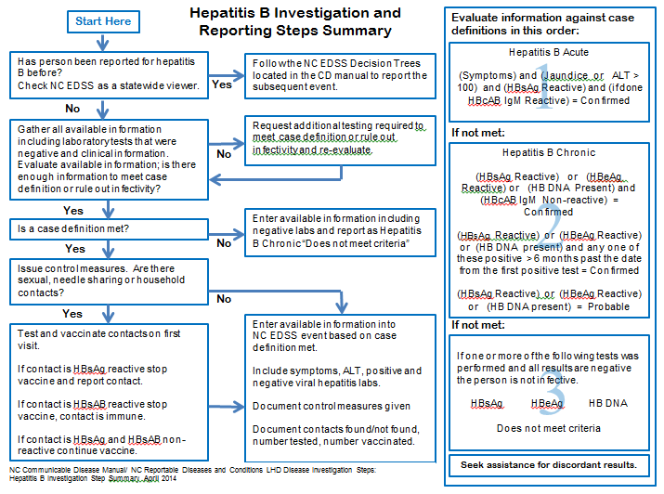
Notes:
This Hepatitis B Investigation and Reporting Steps Summary algorithm provides the steps for investigating and taking control measures for new cases of hepatitis B. The left side of the page provides basic steps to investigate and collect information needed to evaluate and act upon in a case. The right side gives instructions for evaluating cases against case definitions to determine what case classification.
When a person has been previously reported, the algorithm refers to NC EDSS decision trees. These decision trees are additional algorithms that will be covered later in this presentation and can be found in the HBV manual in the Communicable Disease Manual.

Slide 19
Reporting Hepatitis B
If a person has never been reported, determine if they meet a hepatitis B case definition.
Persons who meet a hepatitis B case definition are infectious and require public health action
Notes:
If a person has not been reported before, information must be gathered to determine if the person reported meets a case definition. Sometimes the labs results initially received are enough information to determine whether they are confirmed chronic carriers or do not meet a case definition. Often the initial information received needs to be supplemented with additional information from the provider including negative labs and clinical assessments. The information requested in the Hepatitis B Confidential Communicable Disease Report—Part 2 form or the clinical and risk history and vaccination packages of acute or chronic hepatitis B events serve as a guide for obtaining required information.
When a person meets a case definition, they are considered infectious and require public health actions to not only control further spread of the disease but to also identify potential contacts and provider education and offer vaccination to those who meet the requirements. If a person does not meet a case definition, control measures are not required. However, education about preventative measures may be warranted if the person has risks for the disease discovered in the investigation.

Slide 20
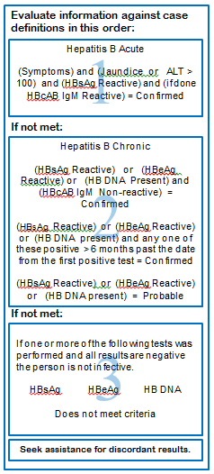
Notes:
Once all available information has been gathered (medical records, , this portion of the Investigation and Reporting Step Summary takes you through evaluating case definitions and classifications. The acute case definition is always considered first. It requires a HBsAg positive test, IgM must be positive if done and then symptoms and jaundice or an ALT ≥ 100.
If the acute case definition cannot be met, the chronic case definition should be considered. If HBsAg, HBeAg or HB DNA is present and an IgM is negative at the same time, the case is confirmed chronic because the virus is present, and the person is not in the acute phase of infection. If HBsAg, HBeAg or HB DNA is present for longer than 6 months, regardless of the presence of IgM, it is chronic confirmed case. If HBsAg, HBeAg or HB DNA are present without the negative IgM or for less than 6 months, the case meets the chronic probable case definition.
HB core antibody IgM is a reportable lab result by North Carolina Administrative Code. A positive IgM will often be reported alone because of this. The positive IgM alone will not meet any case definition because it’s an antibody and cannot not prove the presence of the virus. In most circumstances IgM would not be tested for alone, it would be part of a larger panel that should include HBsAg. Any case submitted with a positive HB core IgM antibody positive must have evidence in the form of a negative HBsAg or HB DNA proving the person does not have active infection to be closed as does not meet case criteria by the State Disease Registrar. Since negative labs are not reportable these labs will need to be requested from the testing provider.

Slide 21
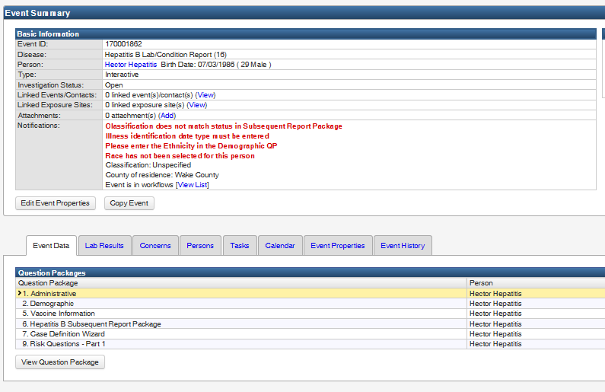
To change a Lab/Condition Report to a Chronic or Acute event, click the
Edit Event Properties button
Notes:
Electronic Laboratory Reports (ELR’s) automatically create NC EDSS events or the DPH receives a paper report, a Hepatitis B Lab/Condition Report event will be created as a place holder to contain the laboratory results.
For persons who have not previously been reported, you must change the Lab/Condition Report to an Acute Hepatitis B or Chronic Hepatitis B event based on your investigation findings. These disease events contain clinical and risk history packages for you to document your investigation findings in. If the person does not meet any case definition it is fine to leave the event as a Lab/Condition Report.
To change the Lab/Condition Report to acute or chronic, click on the “Edit Event Properties” button.

Slide 22
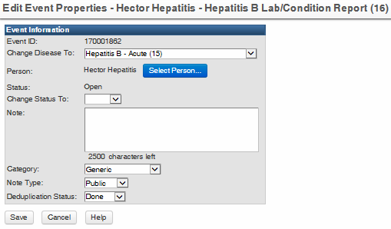
Use the “Change Disease To” drop down to select Hepatitis B Acute or Hepatitis B Chronic
Click on save to save the event under the new disease type
Notes:
When the Edit Event Properties button is clicked, the edit event properties screen will open. In this screen you can change the disease.
To change this screen, use the “Change Disease To” drop down selection. You can choose either acute or chronic. If you choose acute and find later through your investigation that the person does not meet the acute case definition, you can use this mechanism to change the disease to chronic with no loss of data already entered.

Slide 23
Investigating and reporting someone who has been previously reported

Slide 24
Local health department users should never deduplicate hepatitis B events in NC EDSS
Notes:
Because of the nature of hepatitis B reporting with previous reports and ongoing testing over years, local health department NC EDSS users should never deduplicate hepatitis B events. Events should be assigned to the state for merging. If there is an immediate need, call or email the viral hepatitis surveillance coordinator and request deduplication.

Slide 25
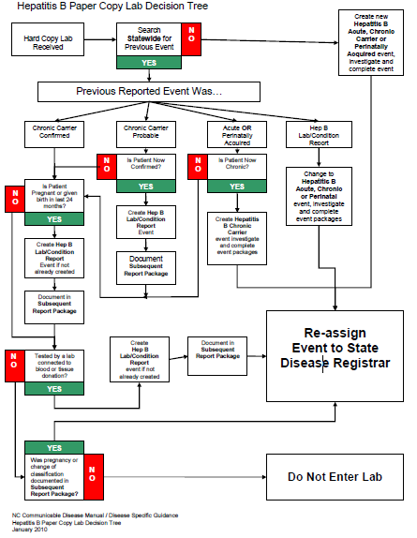
Notes:
For reporting hepatitis in NC EDSS for persons previously reported, there are 2 decision trees/algorithms, one for reports received as paper laboratory results or CD Part 1 reports and one for NC EDSS events generated by Electronic Lab Reports (ELR’s) or paper labs entered by state staff. These decision trees are useful for determining how to handle persons who have been previously reported. By answering yes or no to each block and following the arrows, it will lead you through the reporting process. We will go into detail on how to perform all of the functions required to follow the paths but will not follow every possible path.
These trees can be found in the Hepatitis B manual in the Communicable Disease Manual.

Slide 26
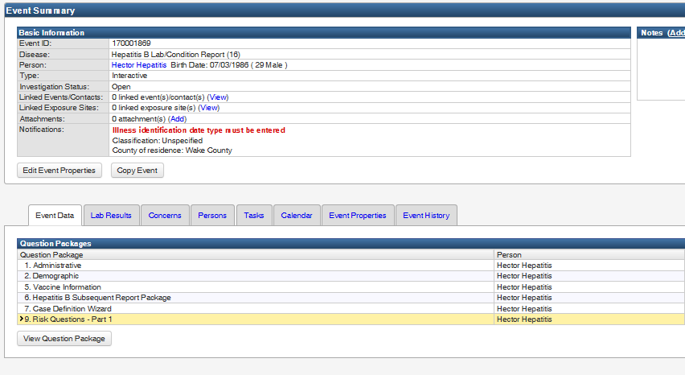
Notes:
Notice the red warning for a missing Illness Identification Date type in this Hepatitis B Lab/Condition Report, the field is found in the clinical package. The Lab/Condition Event does not have a clinic package, so there is no way to complete the field and eliminate the red concern. In this instance it is OK to submit this event to the state with the red concern remaining since there is nothing you can do to get rid of the concern.
The reason the Lab/Condition Event does not have a clinical or risk history package is to prevent any possible changes to those packages when the new event is merged into the original reported event. Using the Lab/Condition Report without the clinical or risk history protects the previously submitted data in an acute or chronic event from being changed.
The Lab/Condition Report mechanism can also be used by the LHD to add attachments such as copies of signed control measures to a closed event as well as deal with additional testing. Simply create a Hepatitis B Lab/Condition Event for the person and attach the document to it. Note in the investigation trail the reason for the event and assign it to the State Disease Registrar. There is no need to complete Subsequent Report Package if no further testing was done

Slide 27
Chronological Listing of Subsequent Reports Matches up to Lab Dates
Notes:
As Lab/Condition Events are received at the state for a person already reported, they will be reviewed by the state and merged into the original reported event for the person. Since the Lab/Condition Event did not contain a clinical or risk history package, there will be no change to those packages.
Subsequent Report Packages will merge into the original event and create a chronological history of reporting for the patient. Labs and attachments will also merge into the original event and be available. The dates for the Subsequent Reports should roughly match the specimen dates for labs received after the initial report.

Slide 28
2. If person has a previous event in your county, click on the magnifying glass search icon to open the event search screen
2. If person has a previous event in another county, hand enter event here
OR
Notes:
To ensure the Subsequent Report is connected with the correct previous event, you will be asked to include the previous event id number. It can be placed in the package in on of 2 ways. If the persons previous event was within your county, you can use the search function within the package. If you found the previous event outside of your county by using the statewide viewer role, you will have to manually type in the event number. The field size is limited and may not take an entire event ID number with a prefix of NETSS, just put in the last 10 digits.

Slide 29
In this case, Hector was previously reported as a probable case, this new lab is more than 6 months from his first reported lab confirming him as a chronic carrier
Notes:
Once the specimen date is entered and the Subsequent Report opens and the previous event id is documented, it is a matter of answering a few questions. For males there should be no information needed you cannot obtain using the persons original report and the current lab information in this event. It should take only a matter of minutes to clear a Lab/Condition Event for a male who has been previously reported. If you found the previous event using the statewide viewer role, you should have noted basic information to prevent the need to access the statewide view again.

Slide 30
For females between the ages of 14 and 50, inclusive, there is a twist. The pregnancy question must be completed
Notes:
If the person is a female between 14 and 50, the pregnancy question must be answered. This does not mean a pregnancy test has been done, it is to be answered to the best of the providers knowledge or the individual's knowledge, is she pregnant or even was she tested because she is pregnant. If the answer is “No”, then event is assigned to the State Disease Registrar. If a person pregnancy status cannot be ascertained form the provider or testing facility the patient should be contacted and pregnancy status should be discussed.

Slide 31
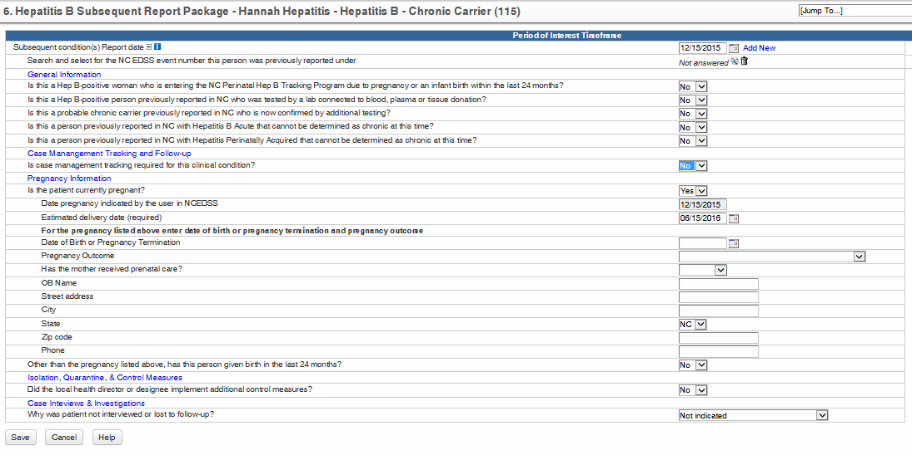
If pregnant is marked “yes” additional fields will open
If the person is pregnant, the EDD is required
Notes:
If the person is pregnant and yes is selected, additional fields will open. Enter the EDD as it is a required field and LHDs are expected to obtain that information from the testing provider and/or patient.

Slide 32
Notes:
For women previously reported as confirmed chronic, the Lab/Condition Event with a pregnancy documented in the Subsequent Report Package can be assigned to State Perinatal Case Management with the reason LHD to Perinatal HEP B Management. If you are in doubt as to where to assign an event, assign it to the State Disease Registrar, if it needs to go to Perinatal Case Management, we will assign it there.
For any other report, Hepatitis B Lab/Condition Events should be assigned to the State Disease Registrar.

Slide 33
Special instances of testing
Life insurance testing
Plasma and blood donor testing
Organ donor testing
Notes:
Life Insurance Companies: The physician for the life insurance company has no clinical relationship with the person and can provide no information about the case. Contacting the life insurance company or their provider does not serve any purpose. The patient’s have not been informed of their test results by the life insurance company and the CD nurse may be the first to tell them of their condition. If a life insurance company is labeled as the provider on a positive hepatitis B lab for a person who has not been previously reported, contact the patient. Provide information about the disease and recommend repeat testing to confirm the results, either by the health department or by the persons own provider if they choose. Ensure HBsAg and anti-HB core total are included in the testing. If the testing confirms the case, provide education, control measures and follow up on contacts.
Plasma and blood donation centers: Every person without a previously reported hepatitis B event that is identified by a plasma or blood donation center should be confirmed by testing through their own provider or the local health department. However, if the patient refuses or is lost to follow-up (per LHD policy) then the CD nurse is finished and the positive from the donation center will be submitted to the state for reporting. Events that have retesting identified as pending will need to remain in LHD workflows
This is in part because the HBV DNA and HCV RNA will show up much earlier than the HBsAg or anti-HBC. Follow-up testing 1-3 month after initial testing could reveal an acute infection.
Call the donation center and request the serologic tests (including negatives) that were performed in addition to those on the DHHS Form 2124 Part 1 and follow the same investigation process you do with all your other HBV events.
Organ Donation Centers: Testing of organ donors is often done postmortem. This blood can often be hemolyzed (ruptured red blood cells). Hemolysis of the blood adversely effects the HBsAg test which can give false positive test results. Investigation with the next of kin should not be undertaken if the only lab present is a single positive HBsAg test. Instead, contact with the patients primary care provider (if known) to assess risk factors and hepatitis status prior to death. NAAT (DNA) testing and anti-HB core total testing should be in agreement with the HBsAg result before doing a contact investigation for a deceased person. Generally all donation centers will perform HBsAg, anti-HBC and HBV DNA testing. If the anti-HBc and HBV DNA are found to be negative with a positive HBsAg the event would not be reportable. If a center performs HBsAg testing only and is confirmed via neutralization an investigation will need to be done and contacts followed. If no contact information is given with the reported labs or, for the next of kin, the event will be closed as a case by disease registrar.

Slide 34
HCV
NCEDSS will automatically create a chronic event for all electronically reported labs (please search (using state wide HBV NCEDSS login) prior to initiating investigations or creating new HCV events for existing events)
Keep in mind that chronic HCV events are not entered into LHD workflows (you will not be able to see these unless you specifically search by person).
Chronic HCV events will only need to be accessed if, information is received that identifies the event as acute: ALT>200 or evidence of jaundice or total direct bilirubin >3.0, a negative lab(s) preceding positive one(s) (within 12 months) and provider notes acute HCV under past/current medical history or under conditions.
Paper copies of HCV labs: If the paper lab has no ALT or total direct bilirubin levels and no mention of acute then NCDPH has been asking (not requiring) LHD’s to create chronic events in NCEDSS with the information they received and transmit that event to the state for closure. Remember LHD’s do not have a workflow for HCV events.
The LHD’s need only investigate HCV events that have:
ALT> 200 or evidence of jaundice or total direct bilirubin level >3.0 and/or Dr. notes received that identify HCV as acute,
(-) lab followed within 12 months by a positive,
Coinfection with acute HBV event (CD nurses at this point would be required to prove that the HCV event was chronic not acute) since the person will meet both acute HBV and acute HCV case
definition.
Coinfection with hepatitis A would make the HCV event immediately chronic.
 | RNA+ | RNA-
Ab+ | Current infection | Old infection cleared, maybe acute
AB- | Acute infection | Susceptible, never infected

Slide 35
Hepatitis C Acute case definition
Clinical Criteria
One or more of the following:
jaundice,
OR
ALT level >200 IU/
Laboratory Criteria for Diagnosis
Confirmatory
(+) HCV RNA (including qualitative, quantitative or genotype testing
Presumptive
(+) anti-HCV
Case Classification
Probable
A case that meets clinical criteria and has confirmatory lab evidence
AND
Does not have a HCV detection test reported
AND
Has no documentation of anti-HCV or HCV RNA test conversion within 12.
Confirmed
A case that meets clinical criteria and has a + HCV NAT or HCV antigen,
OR
A documented (-) HCV Ab, HCV antigen or NAT laboratory test result followed within 12 months by a positive result of any of these tests (test conversion).

Slide 36
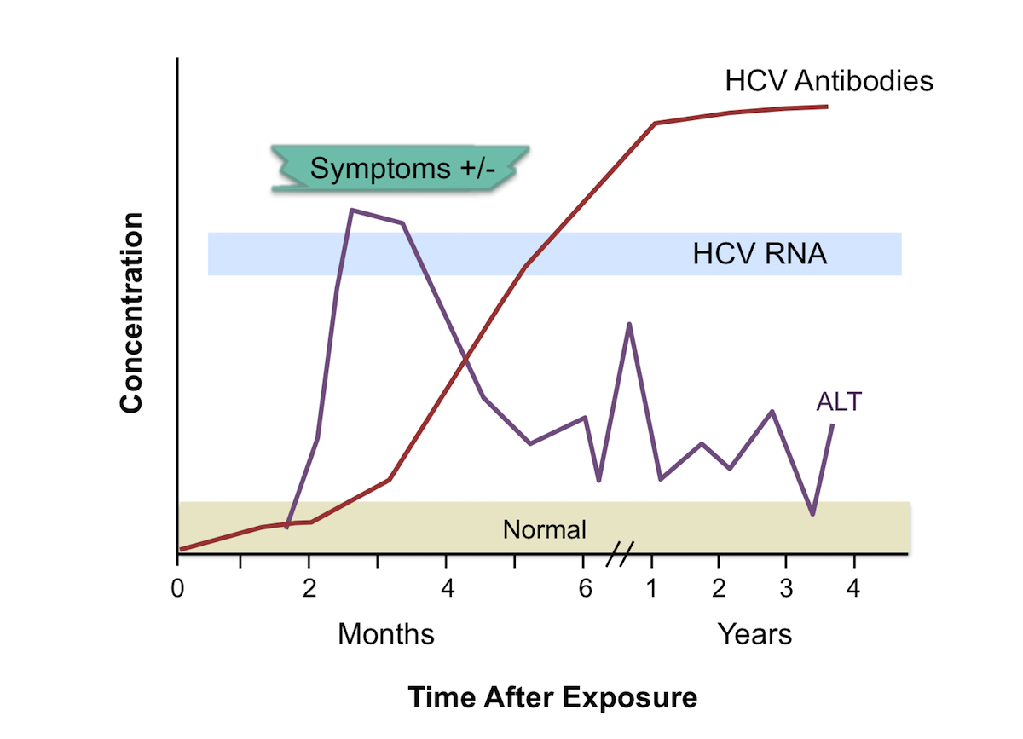
Anti-HCV typically appears around 4 weeks but can take 12 week to become reactive.
HCV RNA typically appears around 2 weeks after exposure.

Slide 37
Summary of Hepatitis B Reporting
If person has never been reported before:
Gather clinical and lab information, including negative hepatitis B labs
Acute must have symptoms
Chronic, confirmed if tests are 6 months apart or negative IgM
Chronic, probable if tests do not include negative IgM or are not 6 months apart
Control Measures in accordance with your health department policy
Contacts testing and vaccination
Advise pt to get retested in 6 Months if not confirmed

Slide 38
Summary of Hepatitis B Reporting
If person has been reported before and the report was:
Chronic, do not change Lab/Condition Report, just complete the Subsequent Report Package
Acute, < 6 months from earliest test, do not change Lab/Condition Report, just complete the Subsequent Report Package
Acute, > 6 months from first test, change Lab/Condition Report to Chronic and ensure pregnancy status is indicated.

Slide 39
LHD Hepatitis B and C Reports
If you want to: create data reports (e.g., to present to Board of Health, create State of the County Health reports, or local fact sheets)
Use | Run Report for | Notes | Date Range
In Report to CDC:
GCDC TATP Reported Case Counts Statistics by MMWR Date (TATP Reported Case Counts CD) | Acute Hepatitis C | Produces total numbers of CD cases reported to CDC by disease, including percentages and a pie chart. (Does not include chronic HCV) | Run one year at a time; recommend last calendar year for dates, but ok to use current year-it’s preliminary
VPD TATP Reported Case Counts Statistics by MMWR Date (TATP Reported Case Counts VPD) | Acute Hepatitis B, Chronic Hepatitis B, and perinatal Hepatitis B | Produces total numbers of VPD cases reported to CDC by disease, including percentages and a pie chart. (Make sure to select “confirmed” for disease classification) | Run one year at a time; recommend last calendar year for dates, but ok to use current year-it’s preliminary
GCDC Demographic Distribution Statistics by MMWR Date (LHD Demographics Distribution CD) | Acute Hepatitis C-confirmed cases | Frequency breakdowns and pie charts for age, gender, race, and Hispanic ethnicity. Only CD cases that have been reported to CDC are included in this report. | Run one year at a time; recommend last calendar year for dates, but ok to use current year-it’s preliminary
In Active Surveillance:
VPD Demographic Distribution Statistics by MMWR Date (LHD Demographic Distribution-VPD) | Acute Hepatitis B, Chronic Hepatitis B, and perinatal Hepatitis B confirmed cases | Frequency breakdowns and pie charts for age, gender, race, and Hispanic ethnicity. Only VPD cases that have been reported to CDC are included in this report. | Run one year at a time; recommend last calendar year for dates, but ok to use current year-it’s preliminary
GCDC Case Counts Chart by Date Marked for Report to CDC (TATP Yearly Report CD Filtered by CDC Base Date) | Acute and Chronic Hepatitis C | Annual case counts (and corresponding bar graph) of CD diseases for the selected county over the previous five years (present year included). (Make sure to select” confirmed” and “probable” for disease classification-County Specific). | Run one year at a time; recommend last calendar year for dates, but ok to use current year-it’s preliminary
If you want to: perform quality assurance, review cases, or identify providers to contact
Use | Run Report for | Notes | Date Range
In Active Surveillance:
All Models Identified Cases and Contacts Line List by Deduplication Date (Event line list – identified (by event create date)) | Any time Closed and/or open Confirmed or not | Line list of all cases and contacts that meet the selected parameters. Includes demographic information, reporting county, symptom onset (if applicable) and investigation dates, and clinical outcome. (For HCV remember to include both “confirmed and “probable” cases. | Run one year at a time; recommend last calendar year for dates, but ok to use current year-it’s preliminary
In Custom Reports:
Event line list – deidentified (by event create date – security profile used) | Any time Closed and/or open Confirmed or not | Can include cases not reported to CDC; remember for hepatitis C to include both “confirmed” and “probable” cases. | Run one year at a time; recommend last calendar year for dates, but ok to use current year-it’s preliminary

