Slide 1
NC Department of Health and Human Services
Early Syphilis Epidemiology in North Carolina 2021
Division of Public Health/Epidemiology Section/Communicable Disease Branch
HIV/STD/Viral Hepatitis Surveillance Unit
December 2022

Slide 2
http://epi.publichealth.nc.gov/cd/stds/figures.html

Slide 3
Early Syphilis^ Cases by Gender 2001-2021
^Early syphilis is defined as primary, secondary, or early non-primary non-secondary (formerly early latent) syphilis.
*2020 data should be treated with caution due to reduced availability of testing caused by the COVID-19 pandemic. Data is italicized for this reason.
Data Source: North Carolina Electronic Disease Surveillance System (NC EDSS) (data as of September 7, 2022).

Slide 4
Early Syphilis^ Rates, 2001-2021
^Early syphilis is defined as primary, secondary, or early non-primary non-secondary (formerly early latent) syphilis.
*2020 data should be treated with caution due to reduced availability of testing caused by the COVID-19 pandemic. Data is italicized for this reason.
Data Source: North Carolina Electronic Disease Surveillance System (NC EDSS) (data as of September 7, 2022).

Slide 5
Age Distribution of Early Syphilis^ Cases by Gender, 2021
^Early syphilis is defined as primary, secondary, or early non-primary non-secondary (formerly early latent) syphilis.
*2020 data should be treated with caution due to reduced availability of testing caused by the COVID-19 pandemic. Data is italicized for this reason.
Data Source: North Carolina Electronic Disease Surveillance System (NC EDSS) (data as of September 7, 2022).

Slide 6
Early Syphilis^ Cases by Race/Ethnicity, 2017-2021
Multiple Race
White
Hispanic
Black/African American
^Early syphilis is defined as primary, secondary, or early non-primary non-secondary (formerly early latent) syphilis.
*2020 data should be treated with caution due to reduced availability of testing caused by the COVID-19 pandemic. Data is italicized for this reason.
**Non-Hispanic/LatinX.
Data Source: North Carolina Electronic Disease Surveillance System (NC EDSS) (data as of September 7, 2022).

Slide 7
Early Syphilis^ Rates by Race/Ethnicity 2017-2021
^Early syphilis is defined as primary, secondary, or early non-primary non-secondary (formerly early latent) syphilis.
*2020 data should be treated with caution due to reduced availability of testing caused by the COVID-19 pandemic. Data is italicized for this reason.
**Non-Hispanic/LatinX.
Data Source: North Carolina Electronic Disease Surveillance System (NC EDSS) (data as of September 7, 2022).

Slide 8
Primary, Secondary, and Other Early^ Syphilis Rates by Gender, 2011-2021
^Other early syphilis is defined as early non-primary non-secondary (formerly early latent) syphilis.
*2020 data should be treated with caution due to reduced availability of testing caused by the COVID-19 pandemic. Data is italicized for this reason.
Data Source: North Carolina Electronic Disease Surveillance System (NC EDSS) (data as of September 7, 2022).

Slide 9
Primary, Secondary, and Other Early^ Syphilis Rates in North Carolina and the United States, 2016-2021
^Other early syphilis non-primary non-secondary (formerly early latent) syphilis.
*2020 data should be treated with caution due to reduced availability of testing caused by the COVID-19 pandemic. Data is italicized for this reason.
Data Source: North Carolina Electronic Disease Surveillance System (NC EDSS) (data as of September 7, 2022). and Preliminary 2021 Sexually Transmitted Diseases Surveillance, CDC (https://www.cdc.gov/std/statistics/2021/default.htm)).

Slide 10
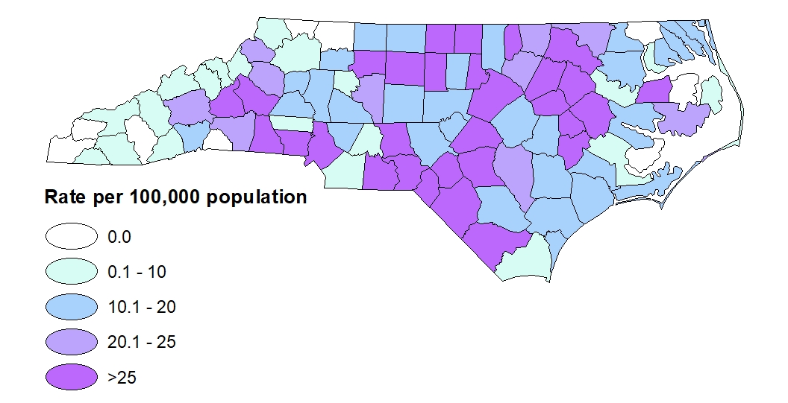
Early Syphilis^ Rates by County 2021
^Early syphilis is defined as primary, secondary, or early non-primary non-secondary (formerly early latent) syphilis.
Data Source: North Carolina Electronic Disease Surveillance System (NC EDSS) (data as of September 7, 2022).

Slide 11
Congenital Syphilis Cases by Birth Year 2011-2021
*2020 data should be treated with caution due to reduced availability of testing caused by the COVID-19 pandemic. Data is italicized for this reason.
Data Source: Sexually Transmitted Disease Management Information System (STD*MIS) and North Carolina Electronic Disease Surveillance System (NC EDSS) (data as of September 7, 2022).

Slide 12
Syphilis Coinfection with HIV

Slide 13
People with Early Syphilis^ Coinfected with HIV^^ by Gender, 2001-2021
^Early syphilis is defined as having primary, secondary, or early non-primary non-secondary (formerly early latent) syphilis.
^^HIV diagnosed prior to OR within 30 days of syphilis diagnosis.
*2020 data should be treated with caution due to reduced availability of testing caused by the COVID-19 pandemic. Data is italicized for this reason.
Data Source: North Carolina Electronic Disease Surveillance System (NC EDSS) (data as of September 7, 2022) and enhanced HIV/AIDS Reporting System (eHARS) (data as of September 2022).

Slide 14
People with Early Syphilis^ Coinfected with HIV^^ by Race/Ethnicity, 2017-2021
Multiple Race
White
Hispanic
Black/African American
^Early syphilis is defined as having primary, secondary, or early non-primary non-secondary (formerly early latent) syphilis.
^^HIV diagnosed prior to OR within 30 days of syphilis diagnosis.
*2020 data should be treated with caution due to reduced availability of testing caused by the COVID-19 pandemic. Data is italicized for this reason.
**Non-Hispanic/LatinX.
† In 2021, 0% of syphilis/HIV co-infections were from Asian/Pacific Islander and Unknown/Unspecified race/ethnicity groups
Data Source: North Carolina Electronic Disease Surveillance System (NC EDSS) (data as of September 7, 2022) and enhanced HIV/AIDS Reporting System (eHARS) (data as of September 2022).

